Slide 1


University
Management System
Team Members -
Mahmudul Hasan Shihan 2221081098
Abdur Razzak 2221081081
Nure Alam Akond Shadin 2221081095
Nusrat Tabassum 2221081101
Submitted To -
Rehnuma Haque
Lecturer Dept. of CSE, UU

Slide 2
Introduction
Objectives
Problem Statement
Used Software Tools
Normalization
Outline-
ER-Diagram
SQL Database
SQL Statement
Future Work
Improvement
Conclusion
01

Slide 3

Introduction -
The University Management System is designed to handle the complex data and relationships involved in managing a university's operations.
The system includes tables for managing addresses, classrooms, course schedules, enrollments, employee information, grades, job details, people, semesters, and student information.
02

Slide 4
Objectives -
To Centralize and manage data related to students, courses, enrollments, and employees.
To Improve data integrity, accessibility, and overall efficiency.
To Facilitate student enrollments and grading.
To Enable efficient course scheduling and classroom management.
03

Slide 5
Problem Statement -
Inefficient management of student information and course schedules.
The lack of a centralized database leads to fragmented data management.
2
3
4
1
High error rates and difficulties in updating information with traditional methods.
Need for improved data integrity and accessibility.
04

Slide 6
Used Software
Tools -
DBMS: MySQL
SQL: Structured Query Language
Development Environment: MySQL Workbench
05

Slide 7
Normalization -
First Normal Form (1NF): Ensuring atomic values and eliminating repeating groups.
Second Normal Form (2NF): Removing partial dependencies on a composite primary key.
1NF
2NF
In our project we have normalized up to second normal form (2NF).
06

Slide 8
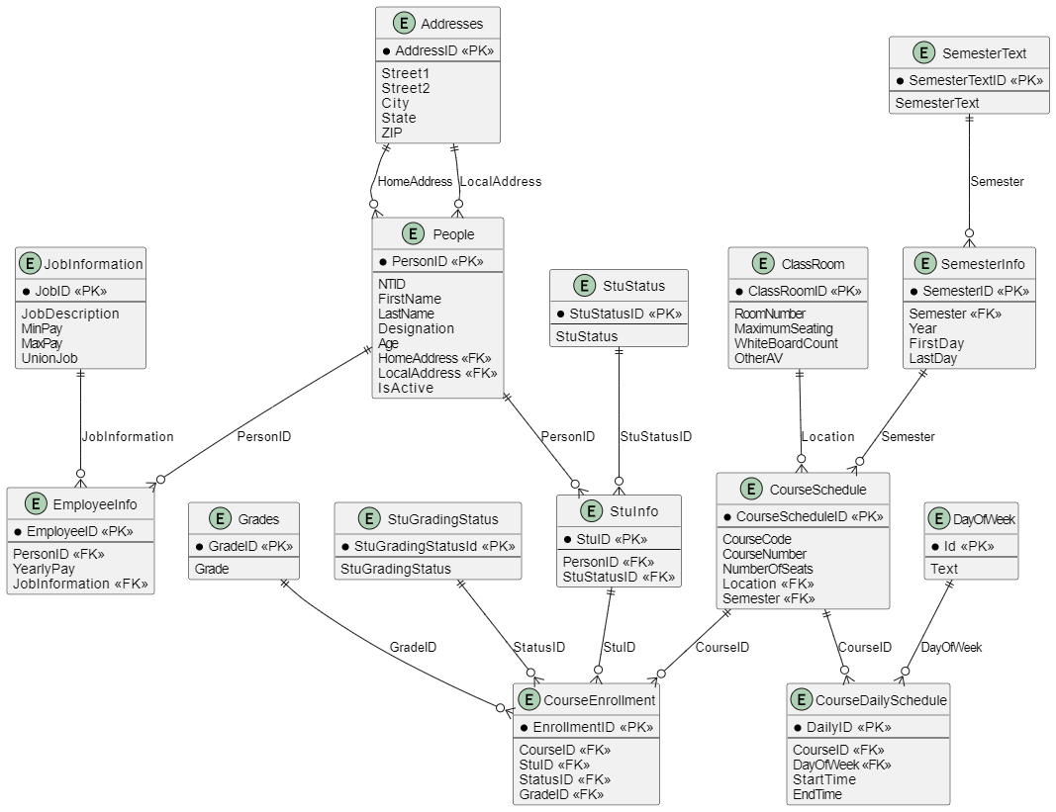
ER-Diagram :
07

Slide 9
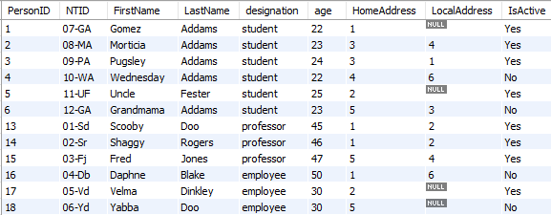
SQL Database :
08

Slide 10
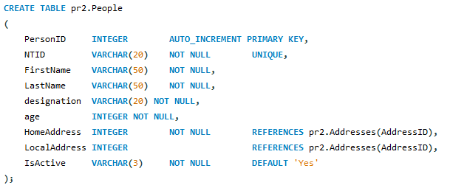
SQL Statement :
09

Slide 11
Future Work -
Further
Normalization
Indexing
Strategies
Data Security
Extending
Functionality
10

Slide 12
User-Friendly Interfaces
System Integration
Improvement -
Automated Notifications
Scalability
11

Slide 13
Conclusion -
The University Management System provides a robust and flexible foundation for managing university operations. By organizing data into well-defined tables with appropriate relationships and constraints, it ensures data integrity, efficiency, and accessibility
12

Slide 14
Thanks

